Slide 1
Writing workshop
Writing in reception

Slide 2
Early Learning Goal
Write recognisable letters most of which are correctly formed.
Spell words by identifying sounds in them and representing the sounds with a letter or letters.
Write simple phrases and sentences that can be read by others.

Slide 3
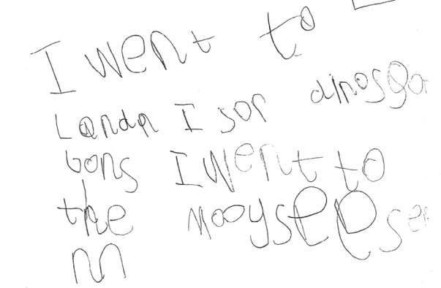

Slide 4
