Slide 1
Writing Workshop
Writing in Year One.
How to help your child to develop their
writing skills.

Slide 2
Writing Workshop
Technology
Technology can be an amazing tool but today’s technology driven world doesn’t allow as many opportunities for writing.
Writing by hand involves more senses and motor neurons than when typing on a computer.

Slide 3
Writing Workshop
Benefits of Writing.
Writing by hand has been shown to increase memory and retention. The act of putting pen to paper activates areas of the brain that helps to increase comprehension skills.

Slide 4
Writing Workshop
In School
In school we encourage children to write sentences by:
Saying what they are going to write out loud.
Sequencing sentences to form short narratives.
Re-reading sentences to ensure what they have written makes sense.

Slide 5
Writing Workshop
In School
We use signs and symbols within our marking policy to help give the children a visual reminder of what needs to be included within their writing.

Slide 6
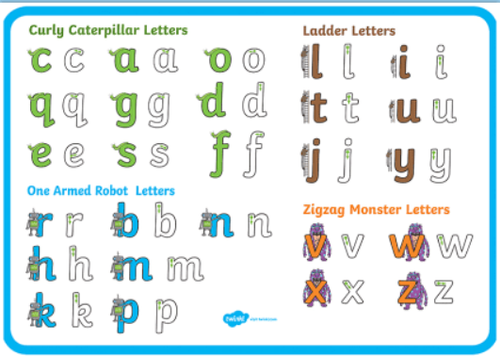
Writing Workshop
In School
In school we help children to understand which letters belong to which handwriting families (letters which are formed in similar ways).

Slide 7
Writing Workshop
In School
We practice handwriting in school daily encouraging children to:
Sit correctly.
Form lower case letters in the correct direction starting and finishing in the right place.
Form capital letters.
Form digits 0 – 9.
Leave spaces between words.
Add adjectives to writing.

Slide 8
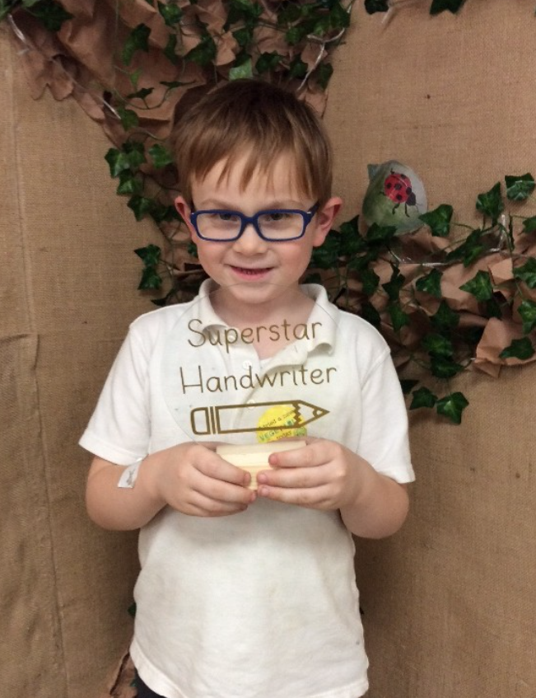
Writing Workshop
In School
It takes time and practice to develop strong writing skills.
We all need to invest time in supporting our children to become more confident in their writing skills.
We celebrate achievement in school daily recognising children’s effort !

Slide 9
Writing Workshop
How you can help at home.
Reading regularly with your child is important!
Reading is a stepping stone to better writing and will help to strengthen writing skills.
Reading helps to develop vocabulary making it easier for them to use in their own writing.

Slide 10
Writing Workshop
How you can help at home.
Making writing a regular habit is shown to increase concentration and deepen thinking.
Writing has been proven to reduce stress, improve focus and attention.

Slide 11
Writing Workshop
How you can help at home.
Make it fun!
Connect writing to their interests. Link with technology to find interesting facts and information.
Plan visits writing before and after they have been.

Slide 12
Writing Workshop
How you can help at home.
Make it fun!
Finger painting.
Writing in a salt or sand tray.
Play word games such as searching for items and writing down what they have found.
Create a writing area.

Slide 13
Writing Workshop
How you can help at home.
Make it fun!
Use different materials for writing.
Shopping lists.
Writing cards.

Slide 14
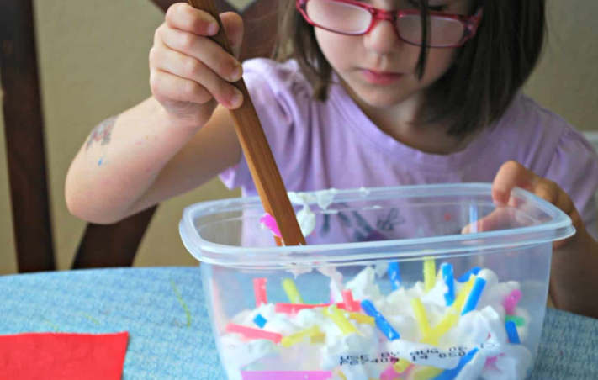
Writing Workshop
How you can help at home.
Make it fun!
Developing fine motor skills are important to help build strength and control to support writing.

Slide 15
Writing Workshop
How you can help at home.
Make it fun!
https://youtu.be/Of7i10EVdtE
https://youtu.be/K7QJ4pdNzvo
https://youtu.be/3K-CQrjI0uY?list=PLZK0awZnUwBuoGJS22vLh3c0jYx2jwjEO

